Slide 1

Presented by Pavan Chaitanya

Slide 2
HAproxy
Agenda:
What is HAproxy?
When to use?
Who uses HAproxy?
Why HAproxy?
Where it can be used?
How to implement?

Slide 3
What is HAproxy?
HAProxy is a free, open-source software load balancer.
It is a proxy solution for TCP and HTTP-based applications.

Slide 4
What is HAproxy?
It is used to distribute incoming traffic across multiple servers to improve performance, reliability, and availability of services.

Slide 5
When to use?
HAProxy should be used when you need to improve the performance, reliability, and availability of your services by distributing incoming traffic across multiple servers.

Slide 6
When to use?
It is also useful when you need to load balance traffic, provide content-based routing, offload SSL processing, and perform other functions at the network layer.

Slide 7
Who uses HAproxy?
HAProxy is used by organizations of all sizes and industries, including large enterprises, small and medium-sized businesses, government agencies, and online service providers.

Slide 8
Who uses HAproxy?
Some of the companies and organizations that use HAProxy include:
Twitter
GitHub
Netflix
Facebook
Amazon Web Services

Slide 9
Why HAproxy?
HAProxy is used because it offers high performance, high availability, and load balancing capabilities.

Slide 10
Why HAproxy?
It is also easy to use and configure, and is open source software, making it a cost-effective solution for organizations that need to improve the performance, reliability, and availability of their services.

Slide 11
Why HAproxy?
Additionally, HAProxy has a large and active community of users and developers, providing users with a wealth of resources and support.

Slide 12
Where it can be used?
HAProxy can be used in a variety of situations where it is necessary to distribute incoming network traffic across multiple servers.

Slide 13
Where it can be used?
Some common use cases include web infrastructure, cloud computing, enterprise networks, online gaming, and content delivery networks.

Slide 14
Where it can be used?
The specific use case will depend on the needs of your infrastructure and the goals you are trying to achieve.

Slide 15
How to implement?
To implement HAProxy, you need to install the software on a server
And configure it with your desired load balancing rules and backend servers.

Slide 16
How to implement?
Once configured, HAProxy can be started and will begin distributing incoming traffic to the specified backend servers.

Slide 17
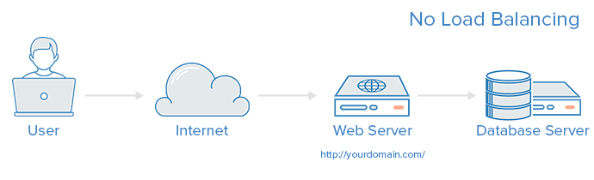

Slide 18
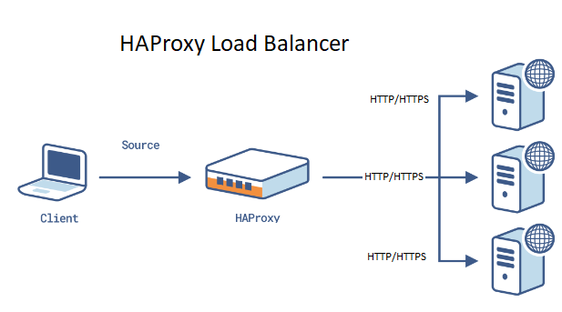

Slide 19
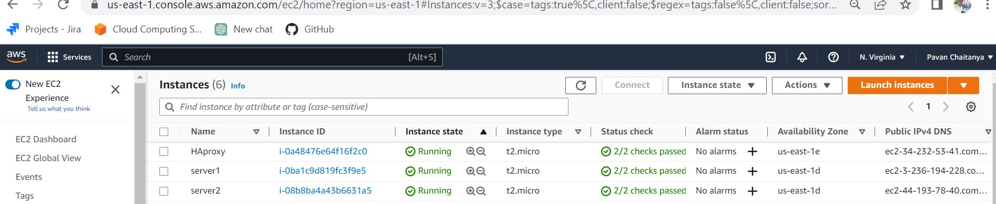
Steps to setup two webservers
Launch Three ec2 instances
1 for Haproxy & 2 for webservers

Slide 20
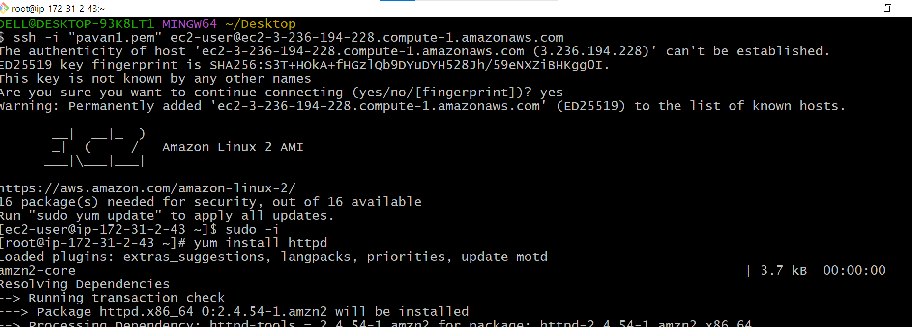
Install webservers on two ec2instances
1.Open gitbash terminal and conncet the ec2 instance
2. yum install httpd --- it used to install the apache

Slide 21
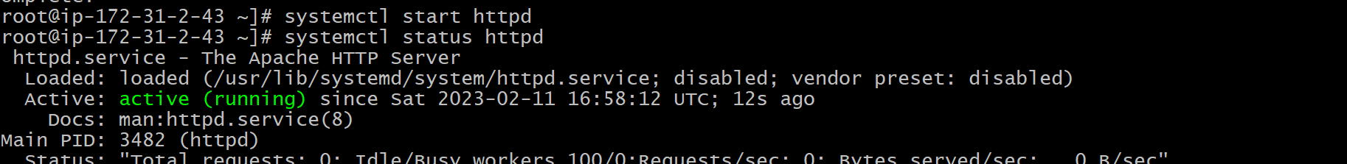
Start the service
1.systemctl start httpd
2.systemctl status httpd

Slide 22
Write sample html code

Slide 23
goto cd /etc
vi hosts give public ip of proxy server(loadbalancer)
Start the services
Ping loadbalancer

Slide 24
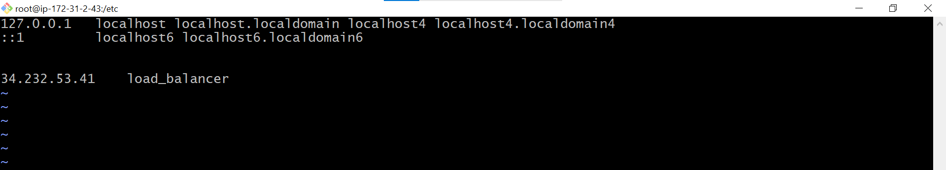
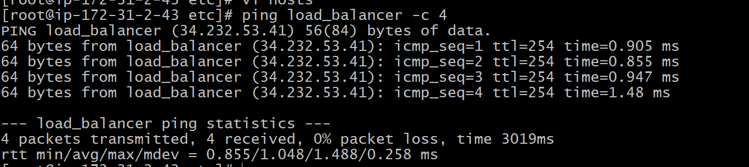

Slide 25
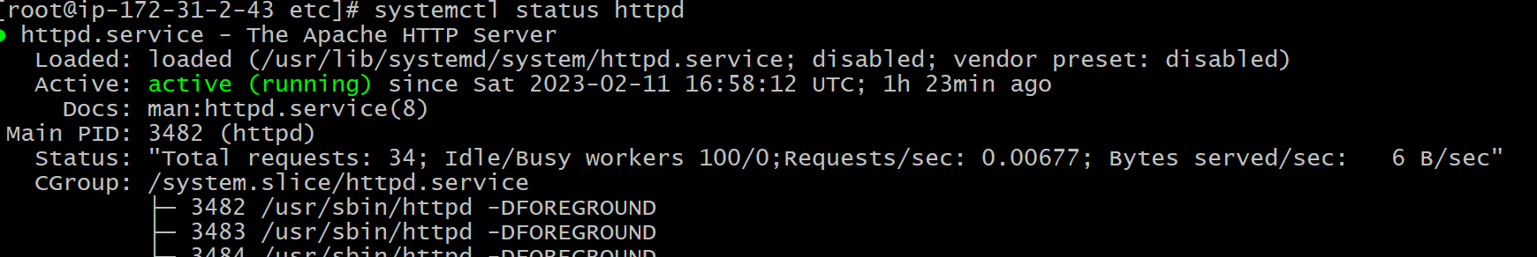
1.systemctl restart httpd
2.systemctl status httpd

Slide 26
Repeat the same steps in server2 also
Make sure to update Server 2's index.html file with a different message.
e.g. "Hello from Server 2," so that when you run a curl command the different message will be displayed.

Slide 27
Steps to setup a HAproxy
Update the packages
Install Haproxy

Slide 28
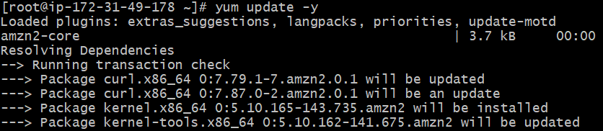
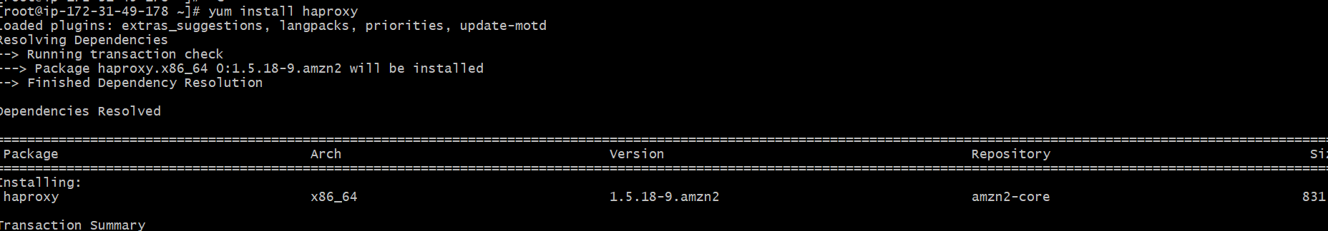

Slide 29
Goto cd /etc
vi hosts give public ip of both ec2instances
Ping both servers

Slide 30
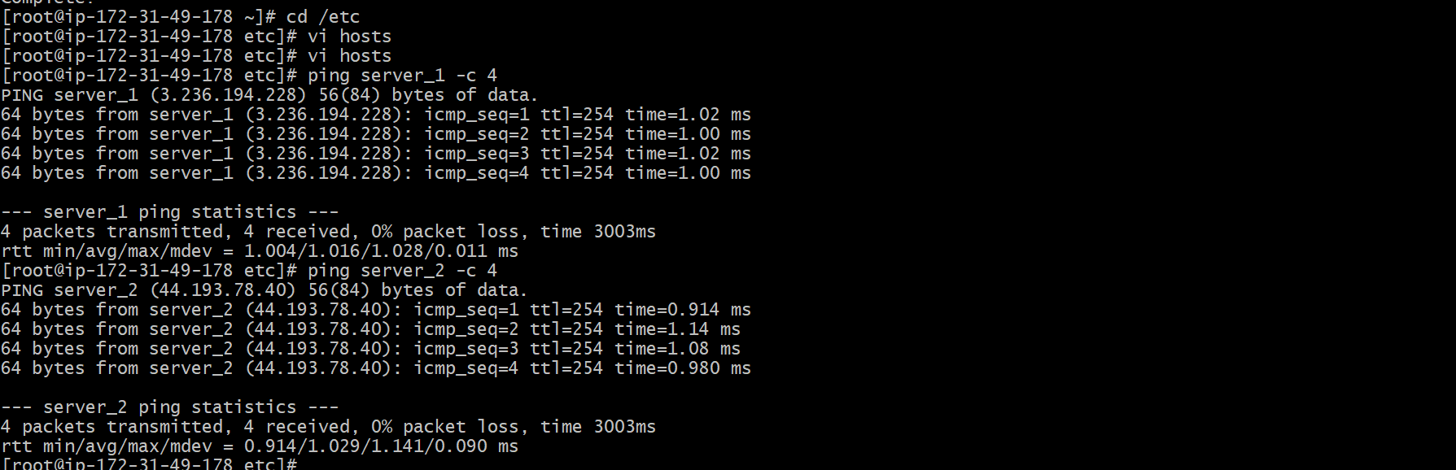

Slide 31
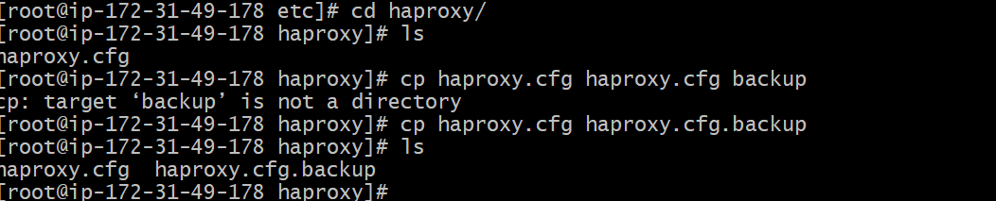
goto cd haproxy/ Backup the haproxy.cfg

Slide 32
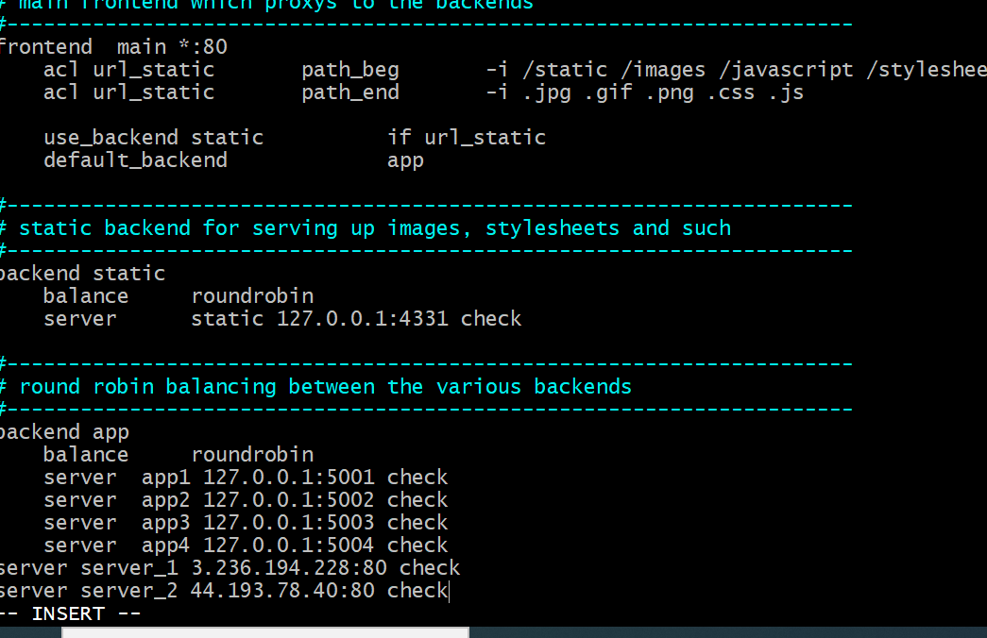
vi haproxy.cfg Give the servers public ip’s and port number 80

Slide 33
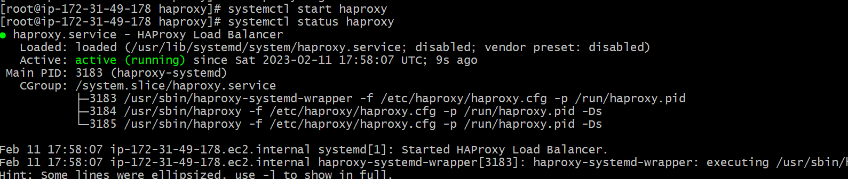
Start service
Start the haproxy and check the status

Slide 34

Curl publicip of server1 & server2

Slide 35
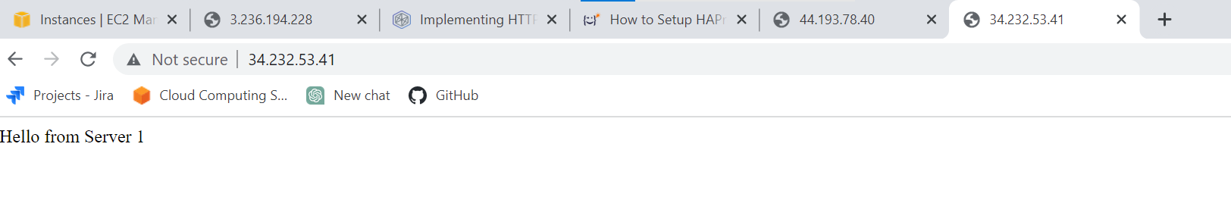

On webbrowser give public ip of Haproxy server Refresh the page it will change the servers

Slide 36
Thankyou very much

